Slide 1
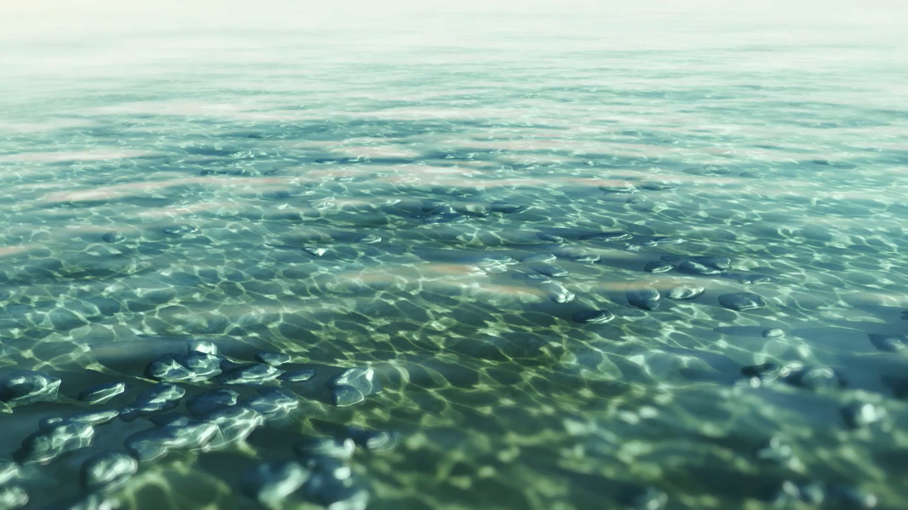


The importance of Water Treatment
By Habib

Slide 2
Water Treatment
Water Treatment refers to the process of improving water quality to serve specific end uses. Examples include: drinking water, industrial purposes, agricultural use, sanitation and many more.
Approximately 1 in 3 people globally do not have access to clean drinking water. This is extremely concerning due to today’s significant technological advancements and knowledge.
Untreated water contain many dangers. Usually harbouring harmful microorganisms such as bacteria and various viruses, diseases such as cholera are commonly spread through its consumption.

Slide 3
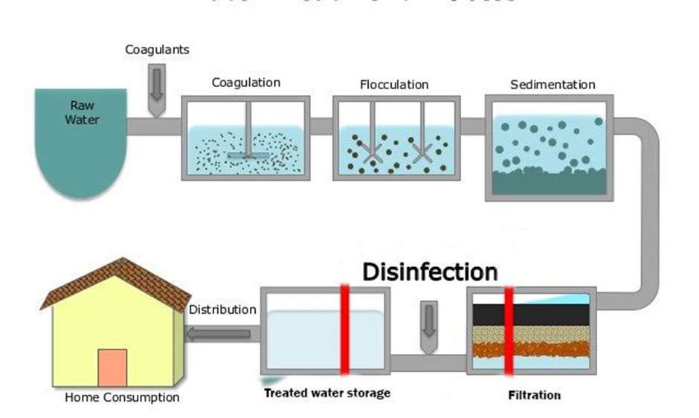
The Water Treatment Process
There are 5 main stages in the Water Treatment process. The stages include: Coagulation, Flocculation, Sedimentation, Filtration and Disinfection.
1. Coagulation: A coagulant (usually aluminium sulfate) us quickly added to water and mixed. The coagulant neutralises the charged contaminants.
2. Flocculation: Flocculants (usually polyacrylamides) are added to water after coagulation. Flocculants bind the small particles which were neutralised by coagulants together. These fall to the bottom of the tank.
3. Sedimentation: Once flocs form, they fall to the bottom, separating the solids from the water.
4. Filtration: Separated, clear water passes through filters with different pore sizes made from different materials like sand and gravel. The filters remove dissolved particles and unwanted substances from the water.
5. Disinfection: Chemical disinfectants are added to water such as chlorine or chlorine dioxide. These remove any final remaining bacteria, viruses or parasites.

Slide 4
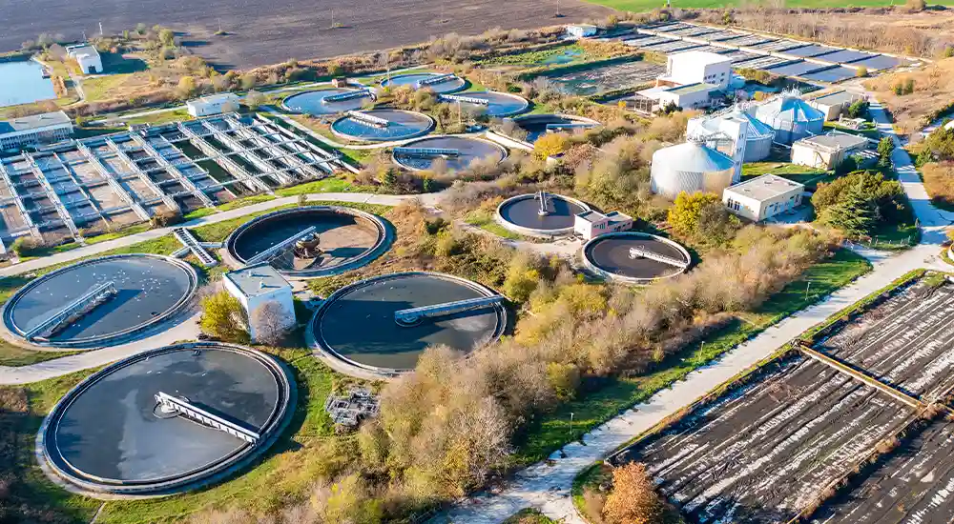
Challenges in Water Treatment
Population growth is a primary challenge in water treatment. As populations increase demands also increase. UNICEF states that half of the world’s population could face water scarcity by 2025.
Contaminants like chemicals, personal care products and drugs have complex structures, as a result when they pollute water it is difficult to remove with conventional water treatment methods.
Water treatment is extremely expensive. Construction and maintenance of water treatment plants require a steep investment, this makes access to clean water challenging especially in developing countries.

Slide 5
Conclusion
Water treatment is vital for public health, environmental protection and universal access to clean water.
Many challenges still remain, usually pollution from chemicals, industrial waste and personal care products.
Advancements in technology offer cheaper and more efficient solutions to battle these challenges. This provides hope for developing countries who may not have the funds to afford conventional water treatment methods.

